Slide 1
Ninjacart Hackathon
Instant Crop Quality Inspection Platform for procurement agents and farmers Cultivate Tech, Develop Farming
Team Naamcheen
Arjun Bakshi
Disha Varshney
Sachin Singla

Slide 2
PROBLEM STATEMENT
Who- Procurement Agent
What- Affordable and quick solution to determine ‘Wheat Grain’ produce quality
Why- Eradicating Corruption, developing Reliable solution and invite the user to perform Random Sampling either to Validate or Suggest changes
How- Tech enabled and operationally well-functioned generation of Quality Test Score for ‘Wheat Grain’ and taking User’s Feedback to Reinforcement Model
When: The user plans to procure wheat grain

Slide 3
Market Research
TAM = Total Wheat grain cultivated in Fy 22-23 X MSP
= 1170 Lakh Tonnes X ₹2125/ Quintal
= ₹24,86,25,000
SAM = Total Wheat grain cultivated in Fy 22-23 X MSP X Indian Milling Companies
= 1170 Lakh Tonnes X ₹2125/ Quintal X 0.8
= ₹19,89,00,000
TG = Total Wheat grain cultivated in Fy 22-23 X MSP X Indian Milling Companies X Smartphone penetration among Indian Milling Companies owners with smartphones X Internet with at least 4G connection
= 1170 Lakh Tonnes X ₹2125/ Quintal X 0.8 X 0.6 X 0.7
= ₹8,35,38,000
Notes:
https://www.tradeindia.com/blog/wheat-flour-market-in-india-growth-forecast/

Slide 4
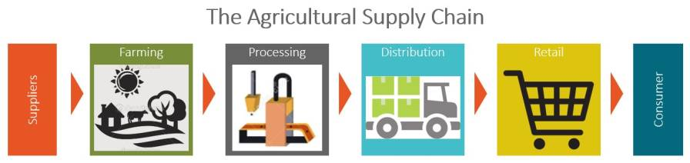
Big Players
ITC - 2 mT
Parle - 1.5 mT
Britannia - 1 mT
Notes:
Source: https://www.business-standard.com/article/companies/britannia-eyes-wheat-import-after-duty-cut-116092800774_1.html

Slide 5
114,000,000,000
Notes:
Source: https://economictimes.indiatimes.com/news/economy/agriculture/indias-wheat-output-may-touch-new-record-of-114-million-tonnes-in-2023-24-provided-normal-temperature/articleshow/106517430.cms?from=mdr

Slide 6
Why Wheat?
Since its domestication around 10,000 years ago, wheat has played a crucial role in global food security. Wheat now supplies a fifth of food calories and protein to the world’s population. It is the most widely cultivated crop in the world, cultivated on 217 million ha land annually.
Notes:
Source:
https://link.springer.com/chapter/10.1007/978-3-030-90673-3_4

Slide 7
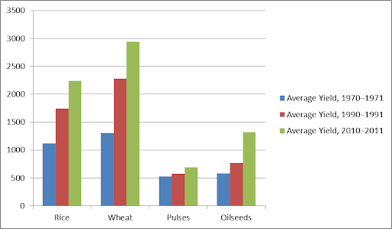

Slide 8
Top Players
Adani Wilmar
Hindustan Unilever
LT Foods
KRBL Limited
Misthan Foods
GRM Overseas
Chaman Lal Setia Exports Ltd
Britannia
Notes:
Sources:
https://www.adani.com/businesses/agri-logistics
https://www.businesstoday.in/latest/corporate/story/adani-wilmar-to-enter-whole-wheat-category-with-brand-fortune-382957-2023-05-26#:~:text=The%20company%20has%20announced%20its,MP%20Grade%201%20wheat%20seeds.
https://tradebrains.in/top-rice-and-wheat-stocks-in-india/
https://www.equitymaster.com/stock-screener/top-wheat-and-rice-companies-in-india

Slide 9
We have built a platform assisting procurement agent

Slide 10





User
Clicks a photo with a camera
Uploads the photo to the platform
Platform calculates the quality and predicts a price

Slide 11

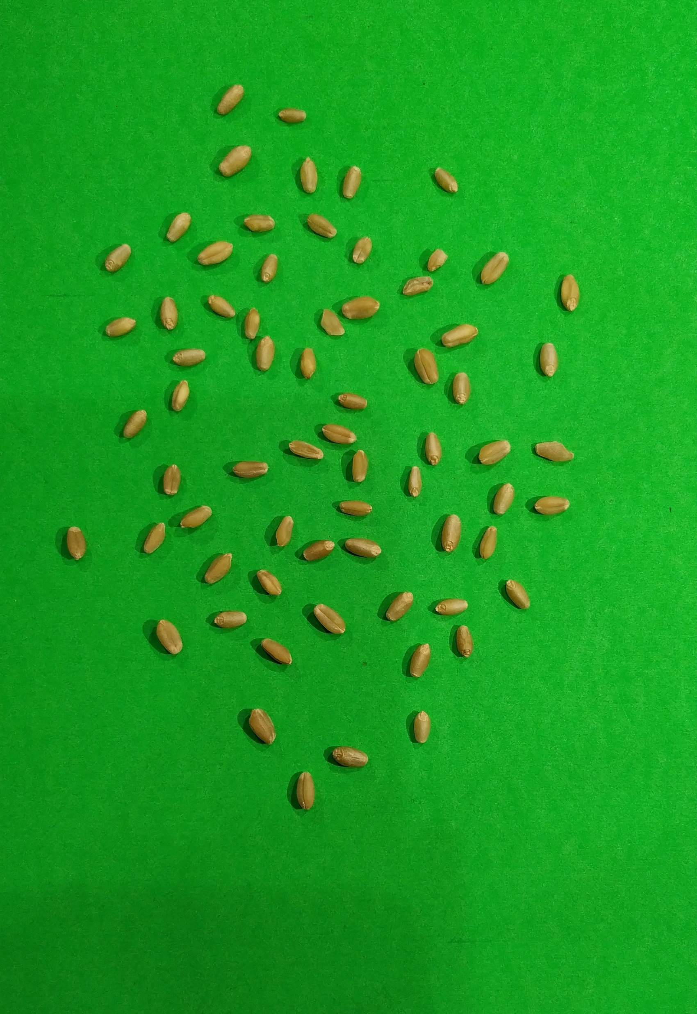
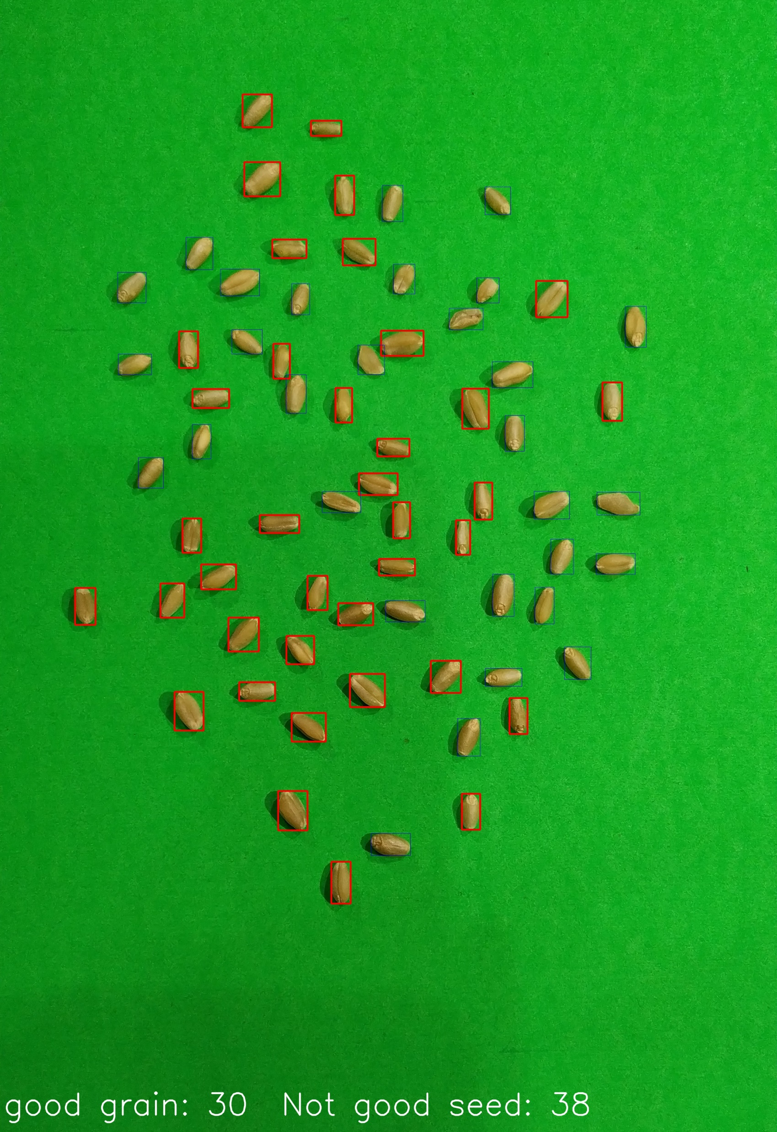

Masked Image
How accurately it is able to segment the grains
Result Image with bounding boxes on each grain
Test Image
Wheat Seeds
Good Grain
Not Good Grain

Slide 12
ML model Demo

Slide 13
ML Model
Recent research papers:
Springer
Codon Publications
Elsevier
Notes:
Dataset: https://www.dropbox.com/s/wcth3i32mpgxzgi/Wheat_Grain_Dataset_easy.zip?e=3&file_subpath=%2Feasy&dl=0

Slide 14
Future Parameters:
Moisture
Soil quality
Fertilizers input

Slide 15
GenAI powered platform experience

Slide 16
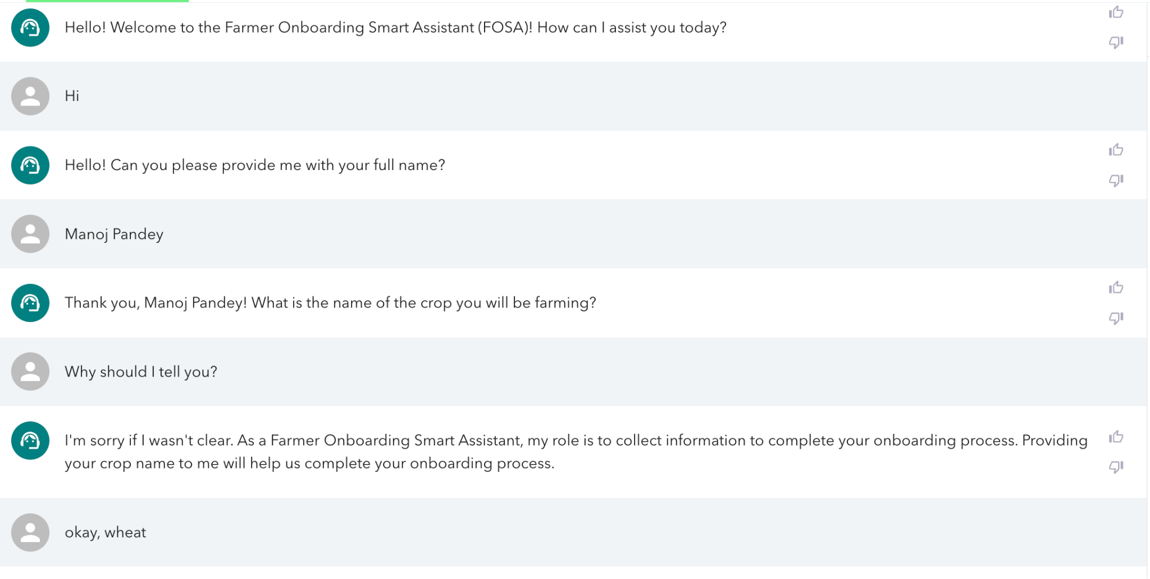

Slide 17
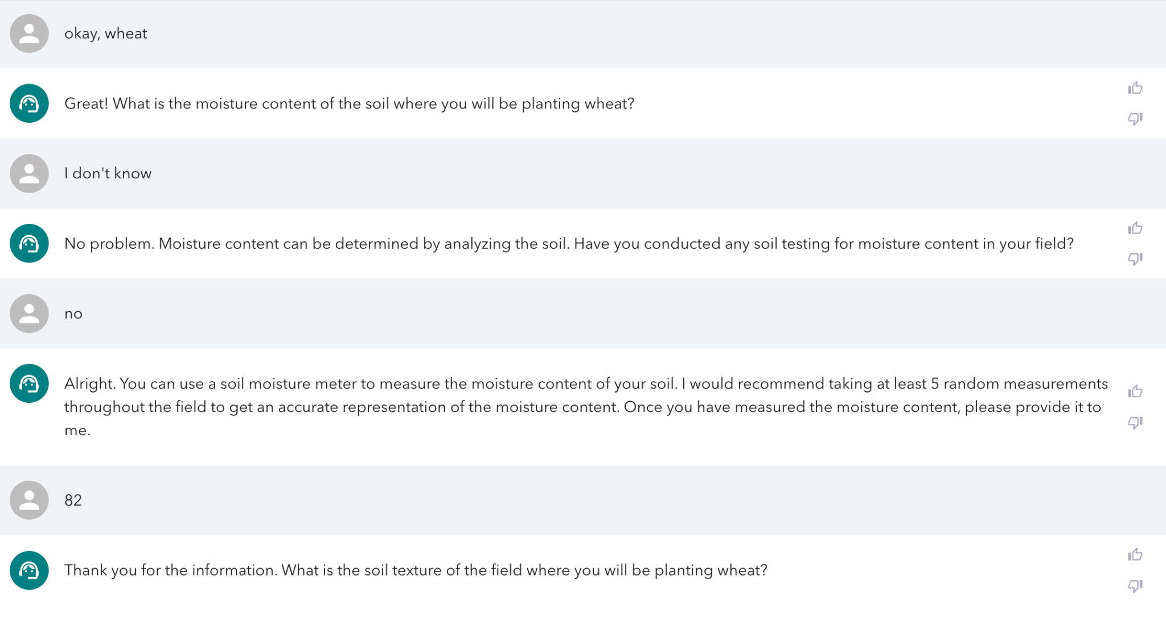

Slide 18
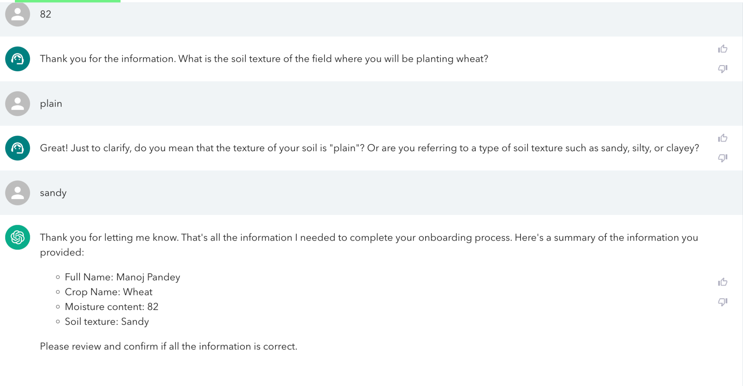

Slide 19
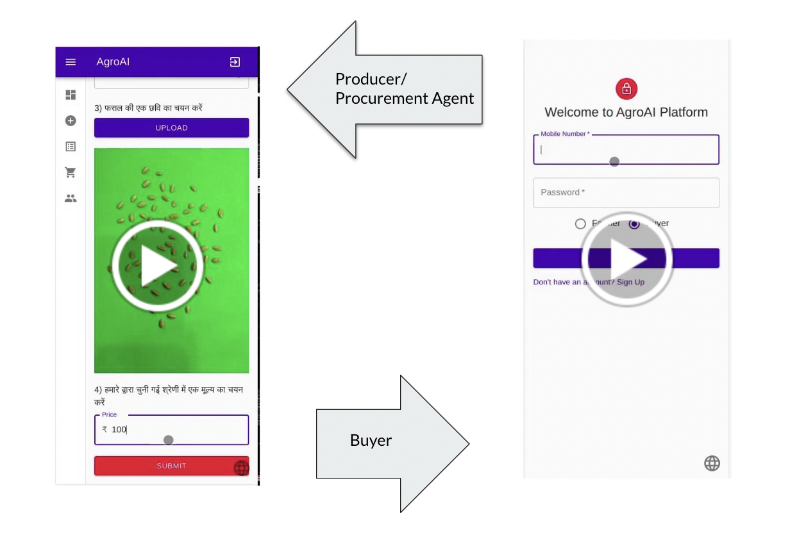

Slide 20
Naamcheen App Demo
Snapshots added in code folder

Slide 21


The idea is NOT to REPLACE, but to COLLABORATE

Slide 22
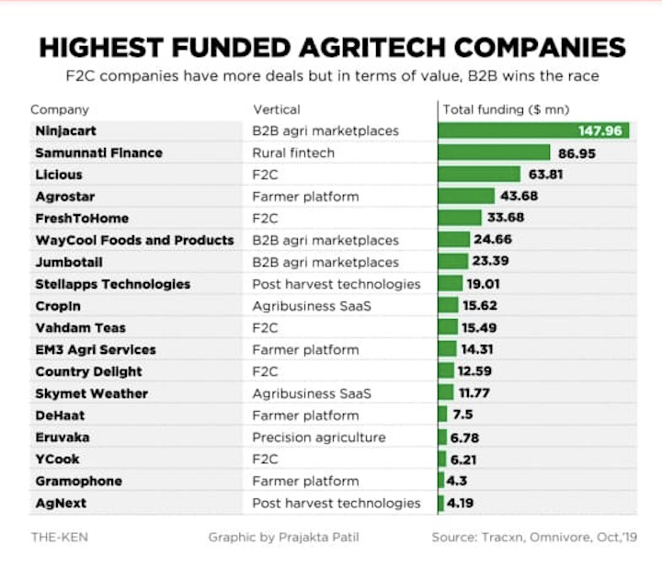

Slide 23
Thanks

